Slide 1
RADIO: Post-Disaster Road Obstruction Identification via Urban Data Fusion
Work-In-Progress Report III
Longbiao CHEN
June, 2017
Notes:
Damage or Debris ?

Slide 2
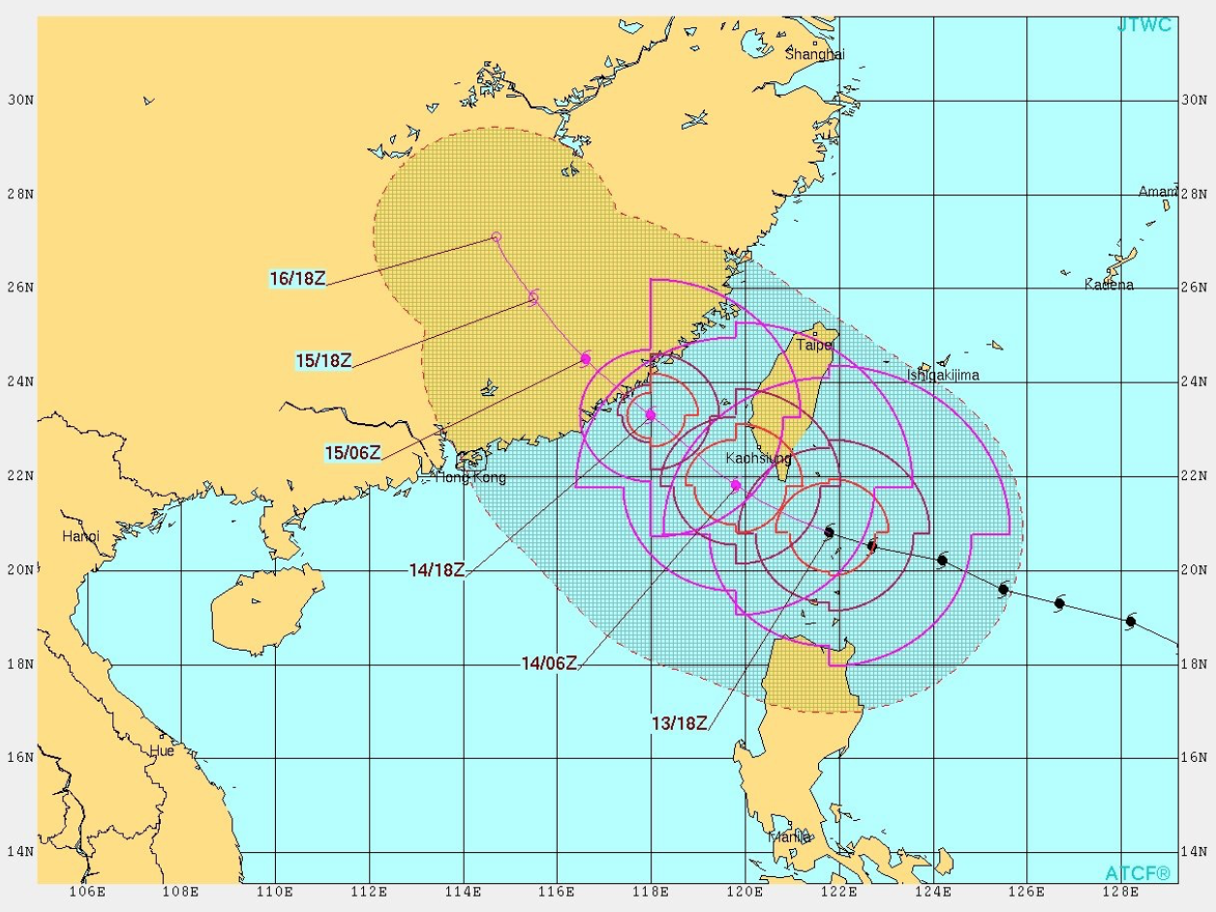
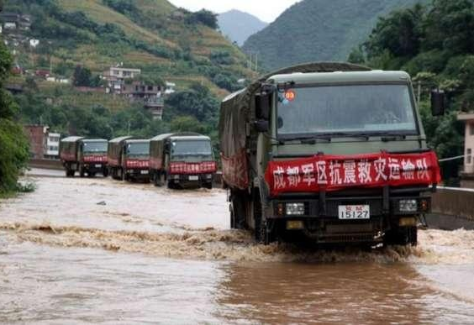
Background
Urban disasters
Types: typhoon, hurricane, earthquake, etc.
Great loss: live, infrastructure, economy
Disaster management
Prevention, Response, Recovery¹
Effective response: save life, reduce loss
Restoration of transportation network
Key to response: search and rescue, evacuation, supply, etc.
1. FEMA (Federal Emergency Management Agency): prevention, response, recovery

Slide 3
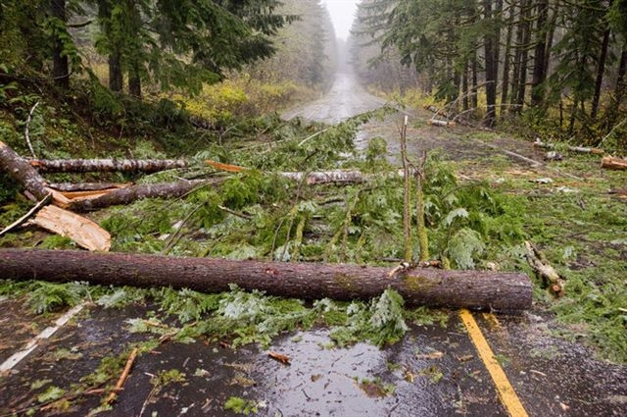
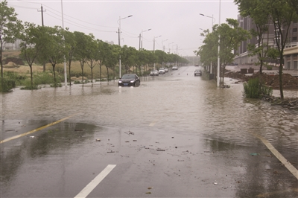
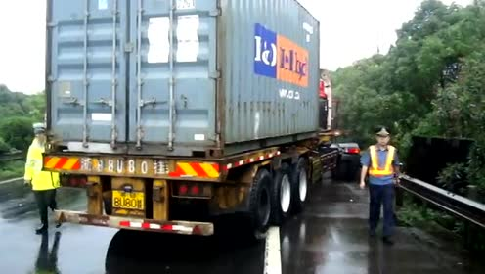
Motivation
Post-disaster road obstacles identification
Detection: when and where
Inferrence: what (fallen trees, ponding water, crashed vehicles, etc.)
Existing methods
Human investigator: labor intensive, delayed, dangerous
Traffic camera: may be damaged, incomplete
A real-time, low-cost, and comprehensive method to identify road obstacles is in great need for disaster relief

Slide 4

Motivation
Vehicle-as-a-Sensor (VaaS)
City-wide GPS trajectories of taxis: New York, Xiamen, etc.
Intuitively: traffic flow changes in road segments
fallen trees → lane blocked → traffic flow decreased
However: changes overwhelmed by the impact of disaster
typhoon → traffic flow decreased significantly → overwhelmed
Find discriminative metrics

Slide 5
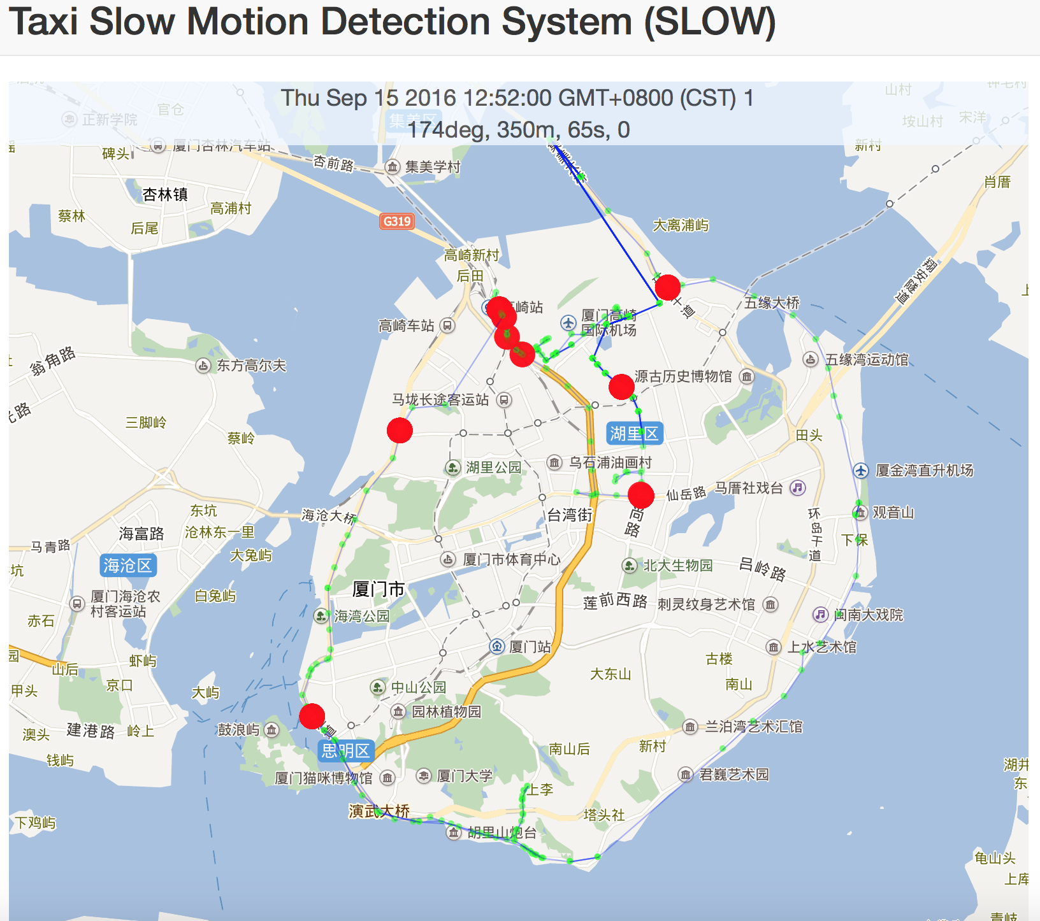
Challenge 1: Detection
Collective driving behavior¹
Fallen trees → slowly bypass/take u-turn/wait
Increase significantly on road segments with damage
Can be extracted from GPS trajectories
Still challenging to extract relevant behaviors
Regular behavior patterns: waiting for traffic lights/passengers
Thresholds: huge parameters tuning for road segments
1. [Yuan, TKDE 2013], [Qi, PerCom 2011], [Liu, CEUS 2010]

Slide 6
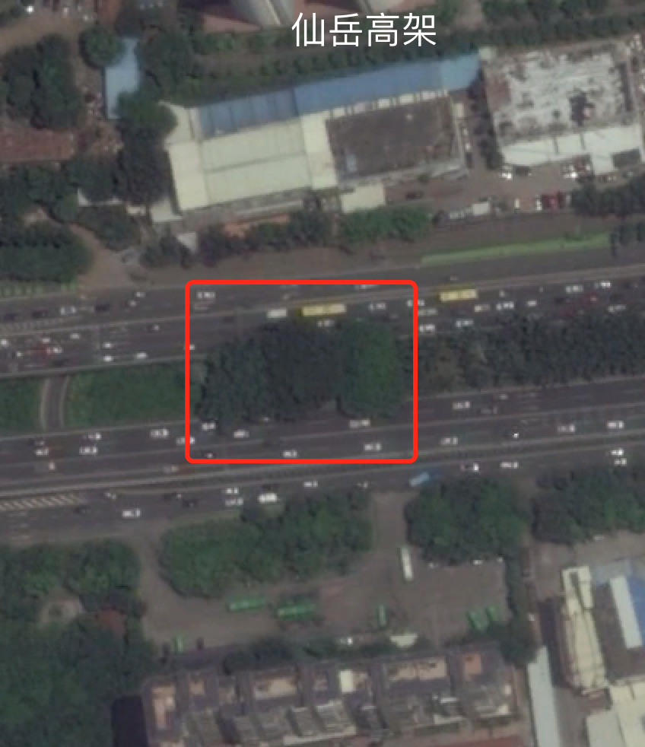
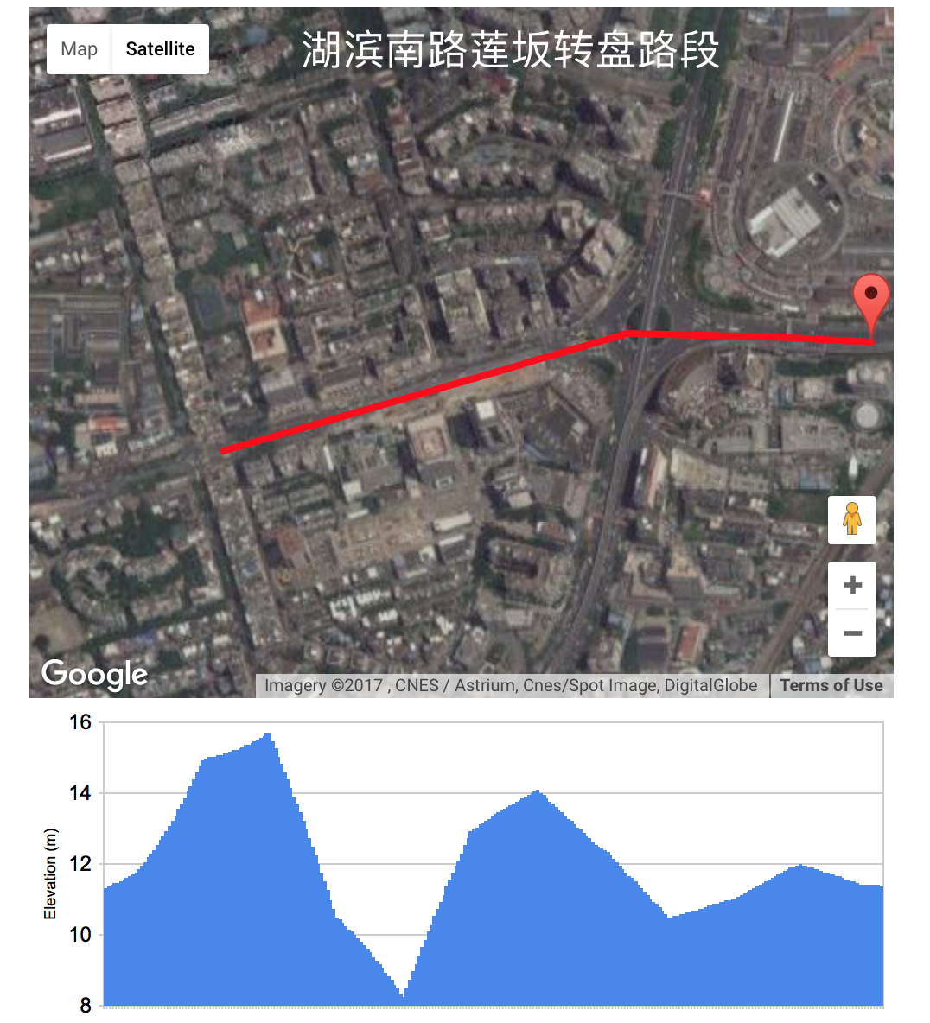
Challenge 2: Recognition
Recognizing road damage types
Difficult from trajectory data only: similar collective behaviors
Incorporating urban knowledge graph
Satellite image: flourish street trees → fallen trees
Digital Elevation Map (DEM): low → water ponds
Accident statistics data → accidents
}
probability
graph
事故热力图

Slide 7
In this paper
Propose a real-time road damage identification system leveraging collective driving behaviors (CDB) and urban knowledge graph
Extract CDB tensor: road segment, time, type → intensity
Detect abnormal CDB cells: Robust PCA algorithm¹
automatically separate behavior patterns and anomalies
adaptive thresholds
Recognize corresponding road damage type: probabilistic graph model²
spatio: maximize likelihood
temporal: consistency constraint
Evaluation: real-world data from Xiamen and NYC
Detection accuracy
Recognition accuracy and case study
[Candès JACM 2011]

Slide 8
Related Work

Slide 9
Framework Overview

Slide 10
Road Damage Detection
Types
Fallen trees
Ponding water
Landslide
Car accidents

Slide 11
Road Damage Recognition

